Slide 1
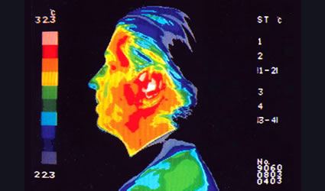
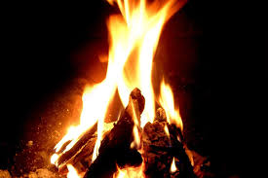
HEAT

Slide 2
ACTIVITIES
Watch the and, in pairs, answer the following questions:
VIDEO
What is thermal energy?
_________________________________________________________________________________________________________________________________________________________
Thermal energy is the energy possessed by an object or system due to the movements of particles within the object or the system
Which is the difference between thermal energy and heat?
____________________________________________________________________________________________________________________________________________________________
Thermal energy is the energy possessed by an object or system connected to the movement of particles, while heat is the energy transferred from an object/system to another one.

Slide 3
ACTIVITIES
With your partner, look at the gaps in the text below. Try to put the right word in each gap. When you have finished, listen to the text to check your answers.
Between make fridge energy temperature end increase plus associated potential
Internal energy is the total ____________associated with atoms and molecules (microscopic components) that a system possesses. It includes the ____________ energy between molecules as well as the kinetic energy of random translational, rotational, and vibrational molecular motion, but it does not include the bulk kinetic energy associated with the motion of the whole system. Internal energy is the thermal energy ___________bond energy. The former is the part of internal energy ___________ with the random motion of molecules, and it is related to temperature: an __________ in energy always corresponds to an increase in thermal energy and vice-versa.
energy
potential
plus
associated
increase

Slide 4
between
Bond energy, by contrast, is the potential energy that exists ___________ molecules.
For this reason, even though internal energy is related to temperature, their relationship is limited: it’s possible for a change in internal energy levels occur in the absence of any temperature variation. This happens, for example, during the formation of ice or the condensation of vapour. The _____________ of these systems remains constant until the ______ of the process.
The everyday use of the word “heat” isn’t often scientifically precise: in everyday terms, you heat a kettle of water to ________________ tea, you cool drinks in the _____________ , the Sun heats the Earth, that heat flows from the stove into a pot of soup, The correct way to define heat is: as energy in transfer between a system and its surroundings when they are at different temperatures. It also covers two systems or two parts of a body or system that are at different temperatures.
temperature
end
make
fridge

Slide 5
ACTIVITIES
In pairs, answer the following questions:
Are internal and thermal energy the same? Why?
_________________________________________________________________________________________________________________________________________________________
Is an increase in internal energy always connected to an increase in temperature? Why?
_________________________________________________________________________________________________________________________________________________________

Slide 6
As heat is energy in transfer by definition, a body never possesses heat! It has an internal energy, but not heat.
Heat always flows spontaneously from a body at a higher temperature to a body at a lower temperature.
This transfer of energy usually, but not always, is an increase in the temperature of the colder body and a decrease in the temperature of the hotter body.

Slide 7
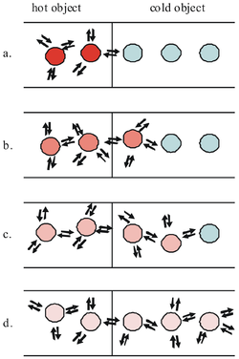
a. As the red molecules in the hot object jiggle and vibrate, they hit some of the blue molecules in the colder object. This transfers energy from the hot molecules to the colder molecules, causing these molecules to vibrate faster. b. - d. Just like dominoes, heat passes along the chain until the energy is spread equally between all of the molecules.

Slide 8
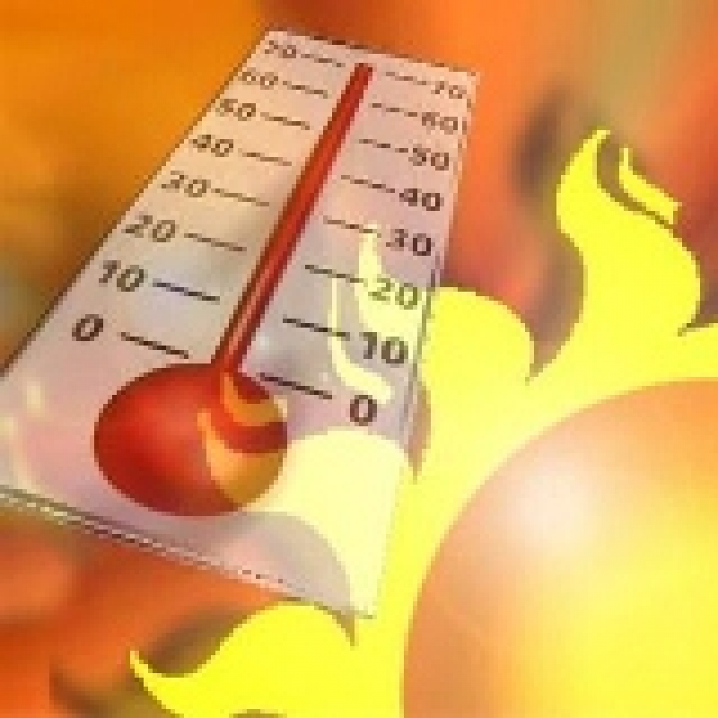
What happens when heat goes into a substance?
1) The substance can experience a raise in temperature. The heat (the added energy) can be realized as an increase in the average kinetic energy of the molecules

Slide 9
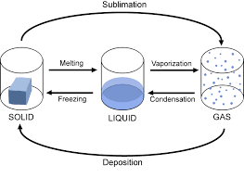
2)The substance can change state (or phase).

Slide 10
The absorbed energy is not used to change the average kinetic energy of the molecules.
The energy is used to change the bonding between the molecules. Changing the manner in which the molecules bond to one another can require an absorption of energy (heat) as in the case of melting, or require a release of energy (heat) as in the case of freezing

Slide 11
UNIT OF MEASURE OF HEAT
Heat=energy
joule=J
Actually, scientists often use 1 calorie (1cal) defined as the amount of energy transfer necessary to raise the temperature of 1 g of water from 14.5°C to 15.5 °C
1Cal=1kcal

Slide 12
HEAT CAPACITY AND SPECIFIC HEAT
ACTIVITIES
Watch the and, in pairs, try to summarise its content.
video

Slide 13
It depends on the substance and on the quantity of substance
Heat added to or released by the system
HEAT CAPACITY, the amount of energy required to raise the temperature of a particular sample of a substance by 1°C.
Unit of measure: j/K – j/°C
Difference between the final temperature of the system and its initial temperature: t_{f}-t_{i}

Slide 14
If an object has a great heat capacity, the difference in temperature is less than the one occuring in a sample with a lower heat capacity (adding the same heat)
The high heat capacity of water keeps its temperature within a relatively narrow range, causing nearby coastal areas to also have a narrow daily and seasonal temperature range. In contrast, areas with similar weather conditions that are farther from the coast tend to have a much wider range of seasonal and daily temperatures. To summarize, large bodies of water tend to moderate the temperature of nearby land due to the high heat capacity of water.

Slide 15
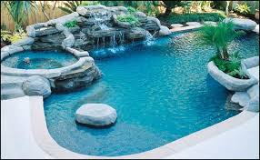
You have to spend a much larger quantity of energy in raising the temperature of a full swimming pool than you do to raise the temperature of a cup of water in the same Δt!

Slide 16
Heat capacity of the sample
SPECIFIC HEAT CAPACITY
It depends on the substance
Mass of the object

Slide 17
Q=CΔt
Q=mcΔt

Slide 18
SPECIFIC HEAT CAPACITY, the amount of energy required to raise the temperature of 1 kg of a substance by 1°C.
Unit of measure: j/kg∙K – j/kg∙°C
Specific Heat of Beryllium | 1830
Specific Heat of Cadmium | 230
Specific Heat of Copper | 387
Specific Heat of Germanium | 322
Specific Heat of Gold | 129
Specific Heat of Iron | 448
Specific Heat of Lead | 128
Specific Heat of Silicon | 703
Specific Heat of Silver | 234
Specific Heat of Sand | 830
Specific Heat of Brass | 380
Specific Heat of Glass | 837
Specific Heat of Ice(-5°C) | 2090
Specific Heat of Marble | 860
Specific Heat of Wood | 1700
Specific Heat of Alcohol(ethyl) | 2400
Specific Heat of Mercury | 140
Specific Heat of Water(15°C) | 4186
Specific Heat of Steam(100°C) | 2010
Specific Heat of Aluminium | 900

Slide 19
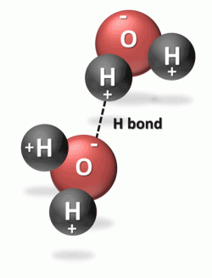
Water is a liquid rather than gas (or water vapor) at room temperature because of the strong hydrogen bond between the molecules of water. (This strong bond causes water to resist molecular motion and remain a liquid at room temperature.) This means that it takes more energy or heat to increase water’s temperature than it does for most other substances.

Slide 20
In pairs, answer the following questions:
A domestic hot water tank contains 200 kg of water at 20°C. How much energy must be supplied to heat this water to 70°C?
_________________________________________________________________________________________________________________
2. The specific heat capacity of steel is 420 J/kgK, what is the final temperature of 2.0 kg of steel when they absorb 200 J at 10°C?
___________________________________________________________________________________________________________________________________________________________________________

Slide 21
There are 4 ways (a-d) to complete the sentences below. Which is correct? Explain why.
Heat spontaneously flows
From a bigger body to a smaller body
Between two bodies in thermal contact
Between bodies in thermal equilibrium
From a body at higher temperature to a body at a lower temperature
Heat capacity
Doubles when you double the quantity of a substance
Halves if the mass of the object doubles
Is constant for any given object
Is inverersely proportional to the object’s mass
Specific heat
Doubles when you double the quantity of a substance
Halves if the mass of a substance doubles
Is constant for a given object
Is inversely proportional to an object’s mass

Slide 22
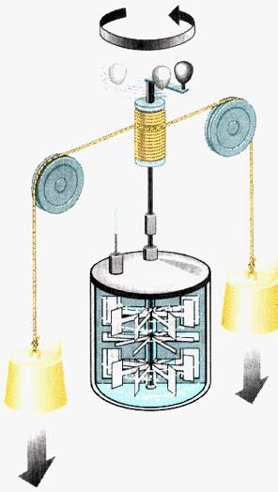
How to convert calories in joules?
Recreation of the Joule’s experiment

Slide 23
W is converted in Q
Misured in J
W=JQ
Misured in J
W=n∙2mgh
Q=m_{wat}cΔt
2nmgh=Jm_{wat}c Δt

Slide 24
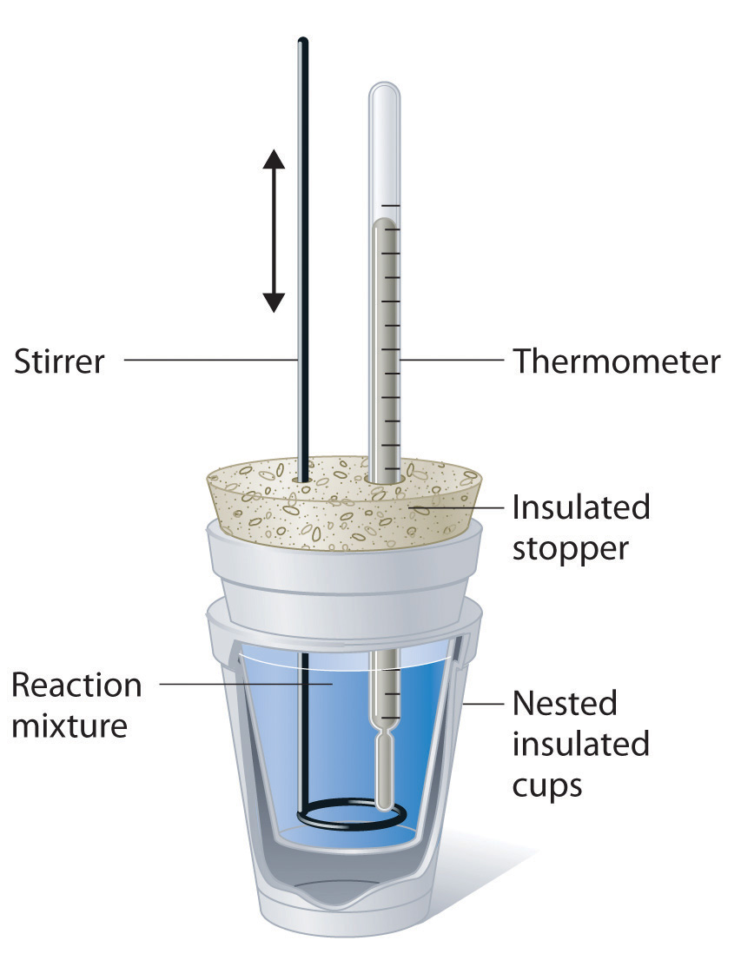
CALORIMETER
A calorimeter is a device made up of an insulated material with a small mass, so to neglect its energy absorbtion
It is well-insulated so that, ideally, no heat enters or leaves the calorimeter from the surroundings. For this reason, any heat liberated by the reaction or process being studied must be picked up by the calorimeter and other substances in the calorimeter.
A thermometer is typically inserted in the calorimeter to measure the change in temperature that results from the reaction or physical process. A stirrer is employed to keep the contents of the calorimeter well-mixed and to ensure uniform heating.

Slide 25
1. What would be the final temperature of a mixture of 100 g of water at 90°C and 600 g of water at 20°C in a calorimeter ?
m₁ = 100 g t_{1i}= 90°C t_{f1}=t_{f2}=t_{f}=?
m₂ = 600 g t_{2i}= 20°C
The first mass will ______ the heat Q₁, while the second one will ___________ the heat Q₂.
Q₁ is ____0, Q₂ is _____0, so that the sum of them is _____ (the calorimeter is heat insulated)
Q₁ + Q₂= ______
Using the formala Q=mcΔt, for each heat we obtain that:
m₁c(t_{f}.t_{1i}) + __________=_____
From which we calculate t_{f}:

Slide 26
2)What would be the final temperature if a 2.0 kg piece of lead at 200°C is inserted in a container with 10 kg of water at 50°C ? (for lead, c = 128 J/kg°C)
__________________________________________________________________________________________________________________________________________________________________________________________________________________________________________________________________________________________________________________________________________________________________

Slide 27
3. A piece of metal weighing 59.047 g was heated to 100.0 °C and then put it into 100.0 mL of water (initially at 23.7 °C). The metal and water were allowed to come to an equilibrium temperature, determined to be 27.8 °C. Assuming no heat lost to the environment, calculate the specific heat of the metal.
________________________________________________________________________________________________________________________________________________________________________________________________________________________________________________________________________________________________________________________________________________________________________________________________________________________________________________________________________________

Slide 28
Working with your partner, read the text and circle the correct word in the pairs. Then listen to the text and check your answer
An introduction to Heat transfer
Examples of heat tranfer phenomena are everywhere you are!
Conduction heat transfer will be well known to/for you: you will have experienced it if you have ever burnt yourself on/in a hot pan by touching it, or if you have experienced different sensations when touching plastic handles and metal ones.
If you can feel warm air away/around you from the heater in your room, and you are touching the heater, you are experiencing convection heat transfer. A current of warm air in contact to/with the hot heater will rise upward/downward in a bulk motion as cold air falls and replaces it..

Slide 29
The main source of energy in/for life on Earth is the Sun. Electromagnetic waves cover the long distance from/in the Sun and heat the Earth in a process called radiation heat transfer
We refer to different types/effects of heat transfer processes as modes. When there is a temperature variation within a solid or fluid medium, we use the term conduction to refer to heat transfer that occurs across it. By contrast, the term convection refers to heat transfer that occurs between a surface and a muving fluid when the two are at different temperatures. The third mode of heat tranfer is thermal radiation: all surfaces of finite temperature (i.e. different from zero kelvin) emit energy in the form of/between electromagnetic waves. Hence, in the absence of an intervening medium, net heat transfer by radiation will occur between/among two surfaces at different temperatures.

Slide 30
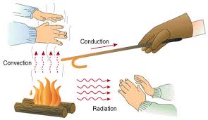

Slide 31
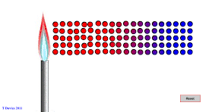
CONDUCTION HEAT TRANSFER
click
Conduction occurs when a substance is heated, particles will gain more energy, and vibrate more. These molecules then bump into nearby particles and transfer some of their energy to them. This then continues and passes the energy from the hot end down to the colder end of the substance.

Slide 32
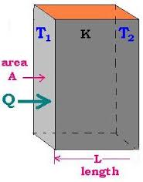
CONDUCTING HEAT IN A BAR
Q∝ΔT
difference in temperature between the two ends of the bar
Q∝A
Cross-sectional area
Q∝Δt
Time interval
Q∝1/d
Thicness of the bar, that is to say the distance heat must travel.
FOURIER’S LAW
d
Thermal conductivity

Slide 33
W
Thermal conductivity measures a material’s ability to allow heat to pass through it via conduction. It is highly dependent on composition and structure. Generally speaking, dense materials such as metals and stone are good conductors of heat, while low density substances such as gas and porous insulation are poor conductors of heat.

Slide 34
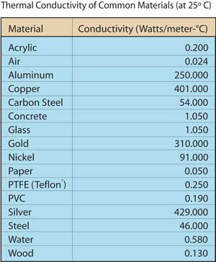
Δt∝1/k
A high coefficient means heat moves very quickly-> thermal conductors; a low coefficient means heat moves very slowly ->thermal insulators
For metals the thermal conductivity is quite high, and those metals which are the best electrical conductors are also the best thermal conductors. Heat and electrical transport both involve the free electrons in the metal.

Slide 35
Boards molecules vertical difference components caused lighter contact atmospheric external
CONVECTION HEAT TRANSFER
Convection heat tranfer occurs when there is a ………………… in temperature between a fluid in motion an a bounding surface. This fluid motion consists of a large number of ……………………… moving collectively or as aggregates (i.e. in bulk motion).
Convection heat transfer may be classified according to the nature of the fluid flow.
Forced convection happens when the fluid flow is caused by ……………………… means, such as a fan, a pump, or ……………………… winds. For example, a fan can be used to provide forced convection air-cooling for hot electrical……………….. on a stack of circuit …………….. in a computer.
difference
molecules
external
atmospheric
components
boards

Slide 36
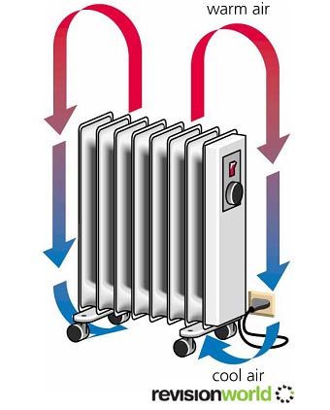
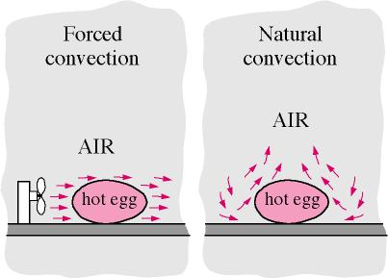
Free (or natural) convection happens when the fluid flow is induced by buoyancy forces, which arise from density differences ……………….. by temperature variations in the fluid.
An example of free convection is the heat transfer that occurs at home in radiators, during the winter. Air that comes into………………… with the hot components of a radiator experiences an increase in temperature, and hence a reduction in density.
As a consequence this air is …………………… than the surrounding air, and buoyancy forces induce a …………………….. motion that replaces the ascending warm air with an inflow of cooler air.
caused
contact
lighter
vertical

Slide 37
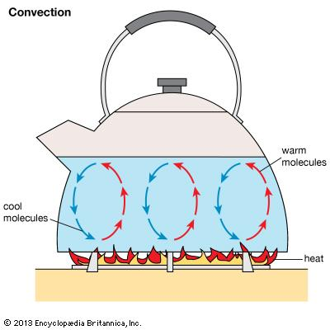
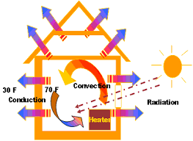

Slide 38
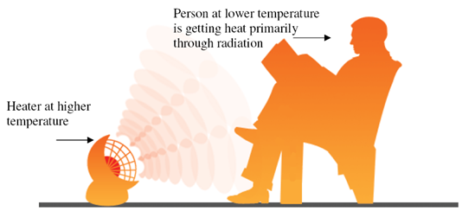
RADIATION HEAT TRANSFER
Radiation is energy emitted by matter at a finite temperature and tranferred by electromagnetic waves.

Slide 39
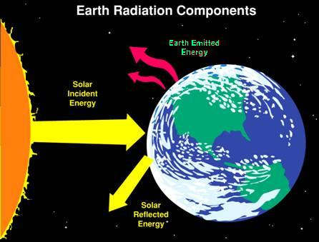
Emission happens as the result of changes in the electron configurations in the material’s constituent atoms and molecules.
While the transfer of energy by conduction or convection requires the presence of a material medium, radiation tranfer occurs most efficiently in a vacuum.

Slide 40
The rate at which this energy is released is proportional to the Kelvin temperature (T) raised to the fourth power.
P∝T⁴
Stefan-Boltzmann’s law
Absolute temperature (K)
Power (in W) radiated from the surface of an object
Area of the surface (m²)
Stefan-Boltzmann constant σ=5.67∙10⁻⁸ W/m²K⁴
Emissivity: 0≤ε≤1
It indicates how efficiently the surface emits compared to an ideal radiator or «blackbody»

Slide 41
Every object not only emits energy but also absorbs it if it’s hit by incident radiation
Absolute temperature (K) of the body
Absolute temperature (K) of the surroundings
Net power (in W)

Slide 42
Fill the gap with the appropriate words or expressions
Surface different place fluid
1) Convection heat transfer takes _______________ between a _________________ and a __________________ that are at ___________________ temperatures.
Finite body temperature occur
2) Radiation heat transfer will _______________ if a _________________ has a __________________ ___________________
That medium temperature difference two points heat transfer
3)When a _______________ exist between _________________ of a medium, conduction __________________ will occur across ___________________

Slide 43
There are four ways (a-d) to complete the sentences below: working in pairs, choose the correct ones and justify your choices
Conduction heat transfer...
Always occurs in the presence of a temperature difference
Happens most efficiently via the motion and interactions of free electrons in metalic bonds
Only occurs between two separate objects at different temperatures
Only takes place between a body at a higher temperature and a body at a lower temperature
Convection heat transfer….
Occurs between a fluid and a surface at different temperatures
Always takes place in the presence of a temperature difference
Only happens in gases
Is the only mode of heat transfer that can occur when there is a temperature difference between two points in a liquid
Radiation heat trasfer…
Only occurs in a vacuum
Occurs only in solids when the sorroundings are at a different temperature
Takes place only in solids
Is always occurring, because every medium has a temperature above zero kelvin

Slide 44
A box with a total surface area 1.50 m² and a side thickness of 2.0 cm is made of an insulating material. There is a 10.0 W electric heater inside the box, and it maintains the box’s internal temperature at 20.0 °C above its external temperature. Find the thermal conductivity k of the insulating material (Remember that P=Energy/time interval)
__________________________________________________________________________________________________________________________________________________________________________________________________________________________________________________________________________________________________________________________________________________________________

Slide 45
The surface of the Sun has a temperature of about 5.800 K, its radius is 6.96∙10⁸m. Calculate the energy radiated by the Sun every second. Assume that the emissivity of the Sun is 0.965.
__________________________________________________________________________________________________________________________________________________________________________________________________________________________________________________________________________________________________________________________________________________________________

Slide 46
Get into a group of three and, using internet, try to explain
why, during the summer, it’s better to wear white clothes and not dark ones
How a thermos flask works
__________________________________________________________________________________________________________________________________________________________________________________________________________________________________________________________________________________________________________________________________________________________________
____________________________________________________________________________________________________________________________________________________________________________________________________________________________________________

